Slide 1

ECE 603 Probability and Random Processes
Lessons 21-24
Chapter 11
Some Important Random Processes
Notes:
Now: Slides with Annotation
Next: Slides with Annotation
*****Preparation Notes*****
Students taking this course should already have covered linear algebra elsewhere.
We will use linear algebra extensively in this course.

Slide 2
Objectives
Explore Poisson processes.
Examine Markov chains.
Explore Brownian Motion, also known as the Wiener Process
Notes:
Now: Slides with Annotation
Next: Slides with Annotation

Slide 3
Rationale
In this lesson, you will consider some of the specific random processes that are frequently found in various applications.
You begin with a review of one of the most widely-used counting processes, the Poisson process, which is used to calculate the probability of the number of events occurring in a fixed time or space.
You then explore the Markov chain, which considers the impact one event has one the next and so on, in a “chain-event”.
Brownian motion, also known as Wiener process, is used most frequently in engineering, finance, and physical science. You will explore its role in probability theory.
Notes:
Now: Slides with Annotation
Next: Slides with Annotation

Slide 4
Prior Learning
Basic Concepts
Counting Methods
Random Variables
Access to the online textbook: https://www.probabilitycourse.com/
Notes:
Now: Slides with Annotation
Next: Slides with Annotation

Slide 5
Some Important Random Processes
Poisson Processes
Markov chains
DTMC
CTMC
Brownian Motion

Slide 6


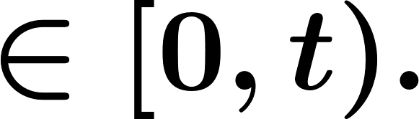
Poisson Processes
Counting Processes
The number of events (arrivals) by time , starting from time 0.
Example. The number of earthquakes in an area during
Example. The number of customers arriving at a store by time .

Slide 7
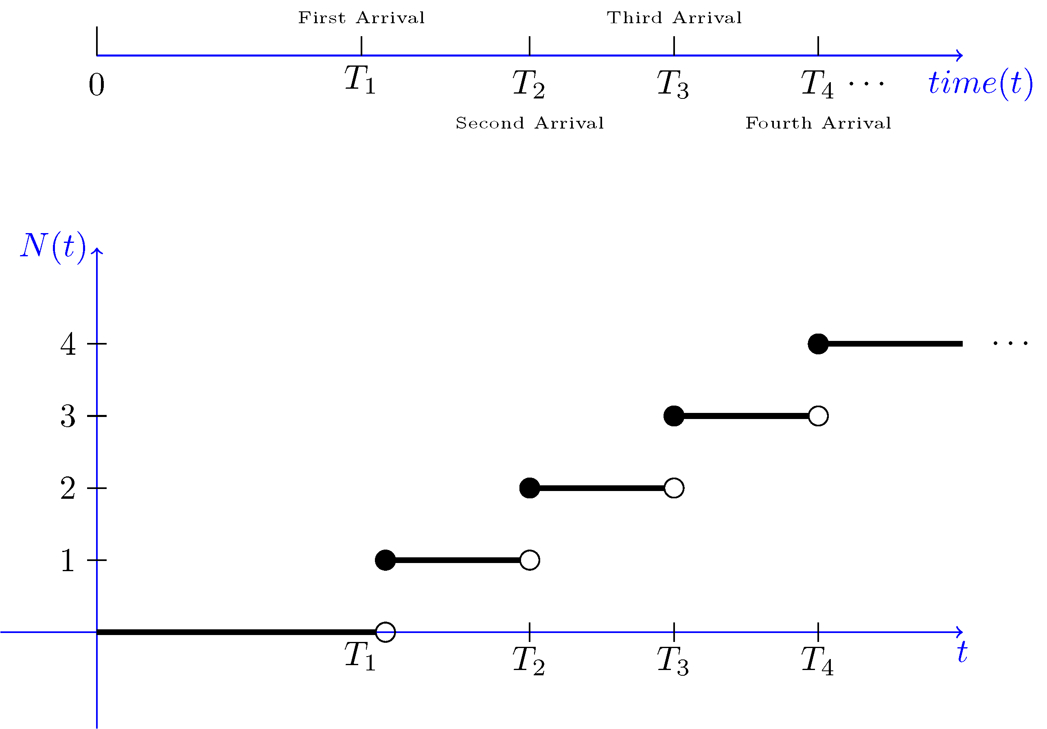


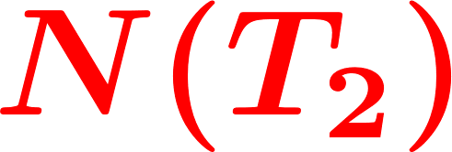
Poisson Processes
the number
of arrivals in (s, t)
arrival

Slide 8
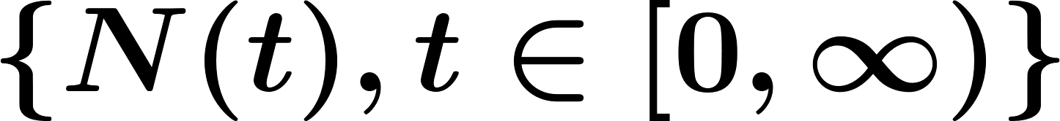
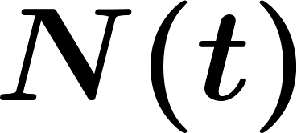
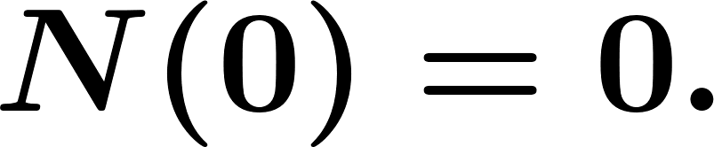


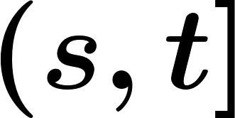
Poisson Processes
Definition. A random process is said to be a counting process if is the number of events occurred from time 0 up to and including time . For a counting process, we assume
, for all
For shows the number of events that occur in the interval .

Slide 9
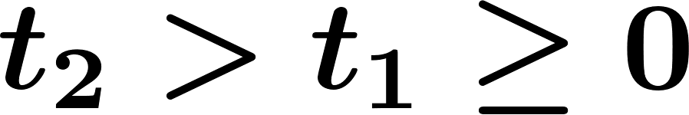
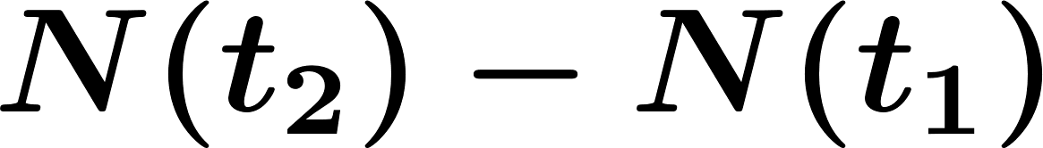
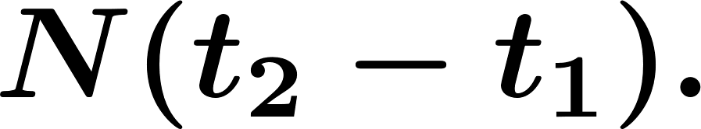
Poisson Processes
A counting process has independent increments if the numbers of arrivals in non-overlapping (disjoint) intervals are independent.
A counting process has stationary increments if, for all ,
has the same distribution as

Slide 10
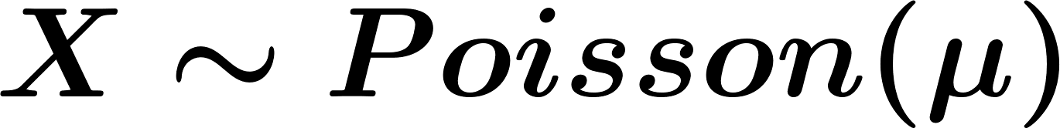
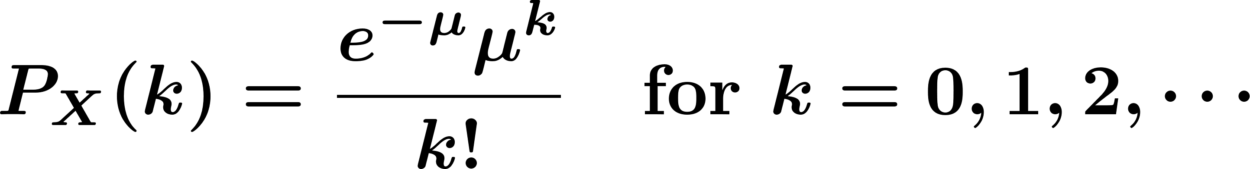
Poisson Processes
Poisson Processes: has independent and stationary increments = events occur completely at random.
Review of Poisson random variable:

Slide 11


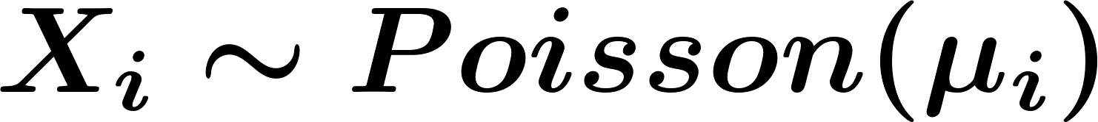
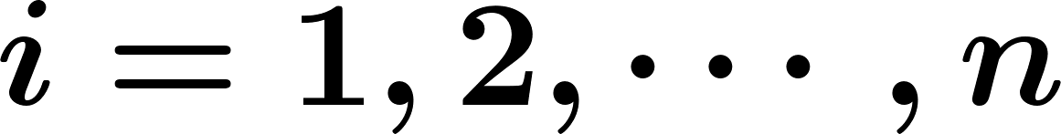
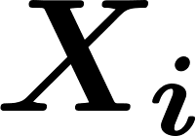
Poisson Processes
Properties:
If , then , and .
If , for , and the 's are independent, then
The Poisson distribution can be viewed as the limit of binomial distribution.

Slide 12

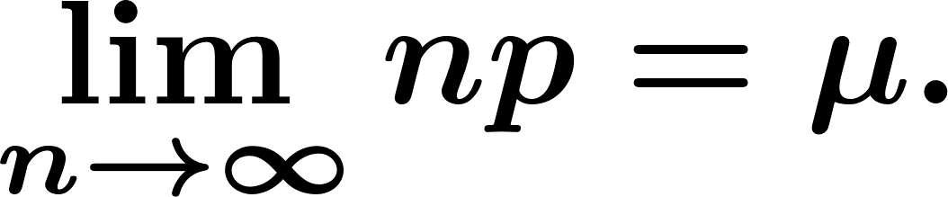
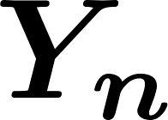
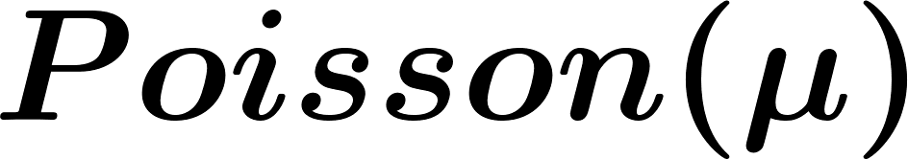


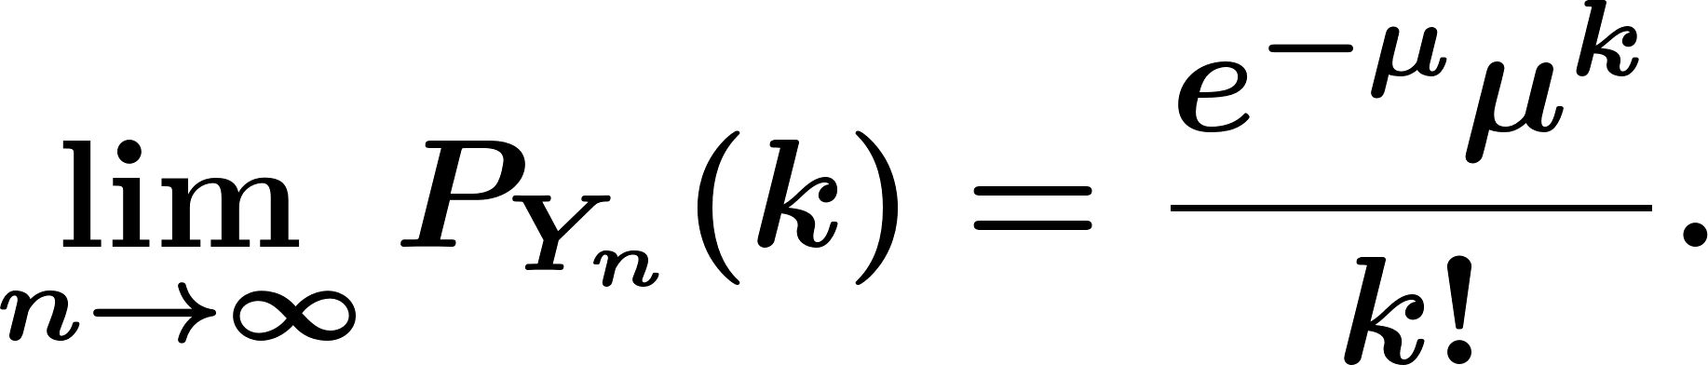
Poisson Processes
Theorem. Let . Let be a fixed real number, and Then, the PMF of converges to a PMF, as . That is, for any , we have

Slide 13

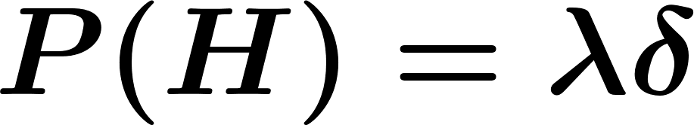


Poisson Processes
Mathematical construction:
Toss a coin in every seconds with
Let
Number of observed ‘s by time

Slide 14
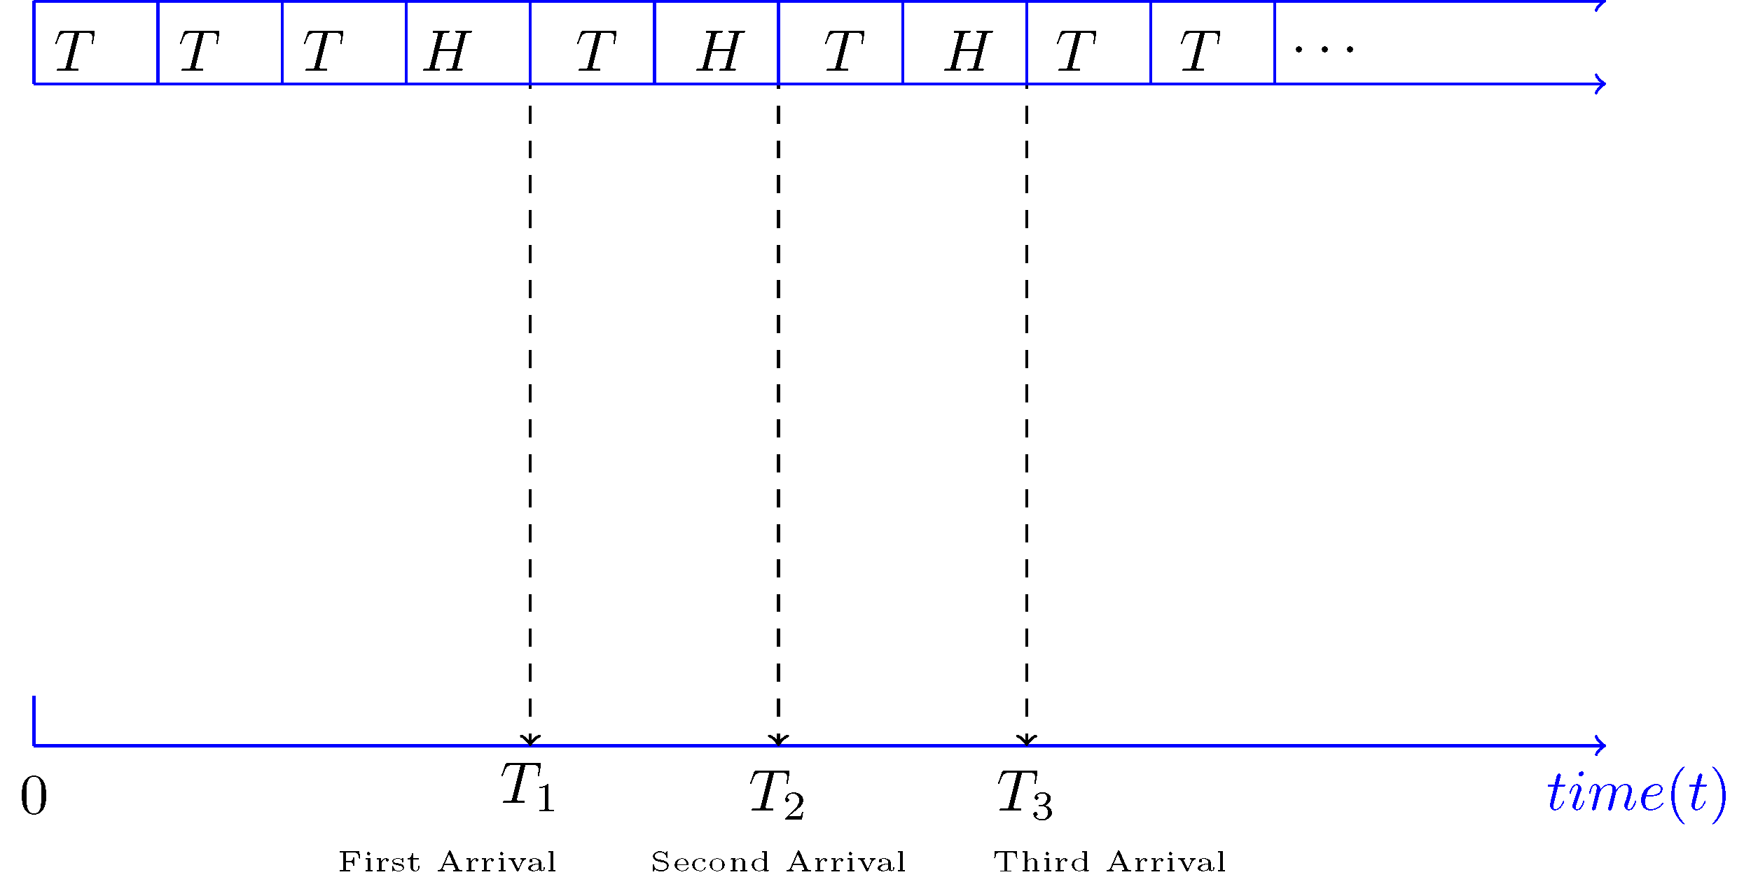
Poisson Processes
Mathematical construction:

Slide 15
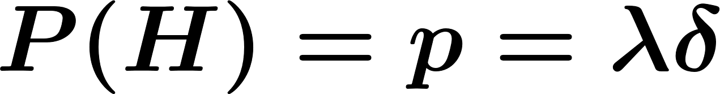
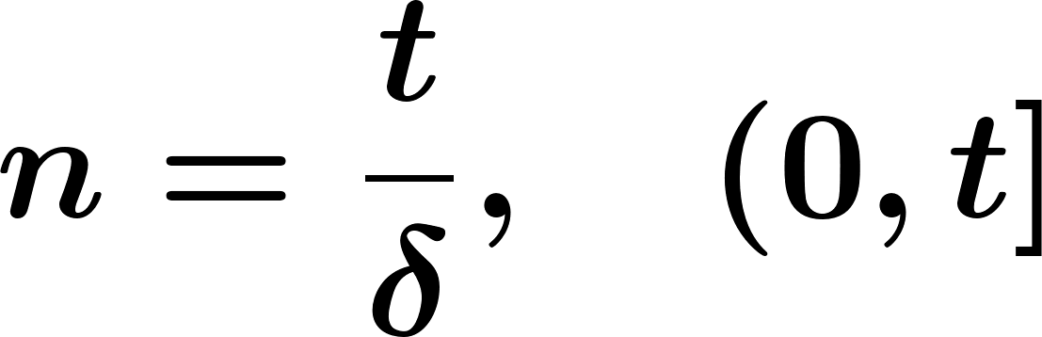
Poisson Processes
the number of arrivals (number of heads) from time 0 to time

Slide 16

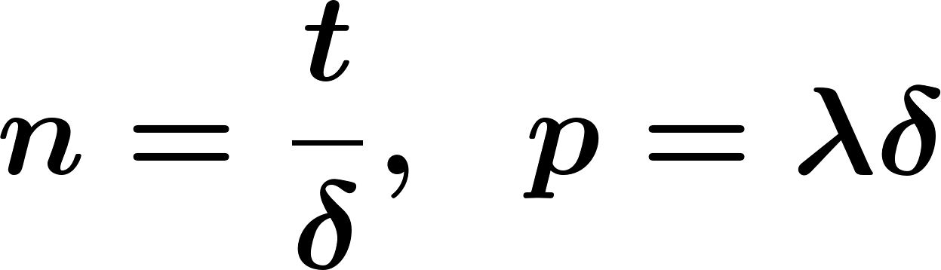
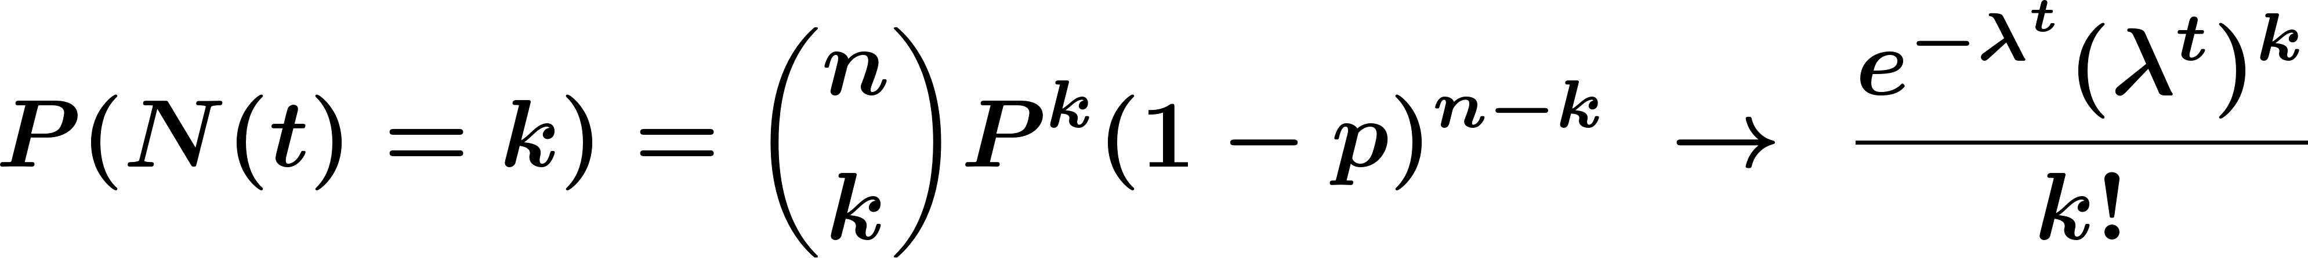
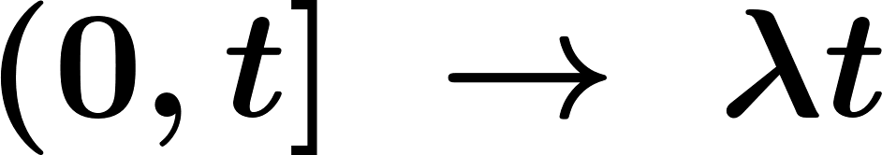
Poisson Processes
Toss the coin time, the number of heads

Slide 17



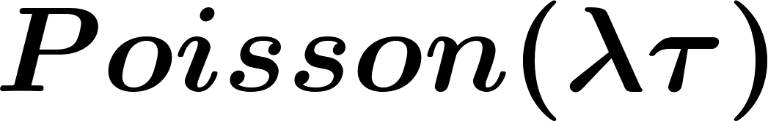
Poisson Processes
The Poisson Process:
Let be fixed. The counting process is called a Poisson process with rates if all the following conditions hold:
has independent increments;
The number of arrivals in any interval of length has distribution.

Slide 18
Poisson Processes
Poisson Processes:
Independent Increments
Stationary increments

Slide 19

Poisson Processes
Example. The number of customers arriving at a grocery store can be modeled by a Poisson process with intensity customers per hour.
Find the probability that there are 2 customers between 10:00 and 10:20.
Find the probability that there are 3 customers between 10:00 and 10:20 and 7 customers between 10:20 and 11.

Slide 20


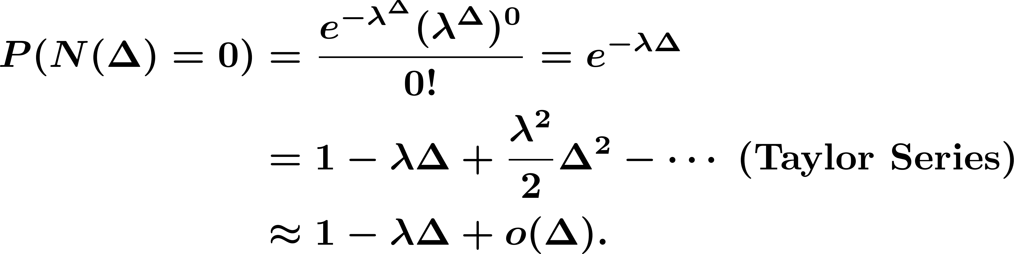
Poisson Processes
Consider the interval where is small.

Slide 21



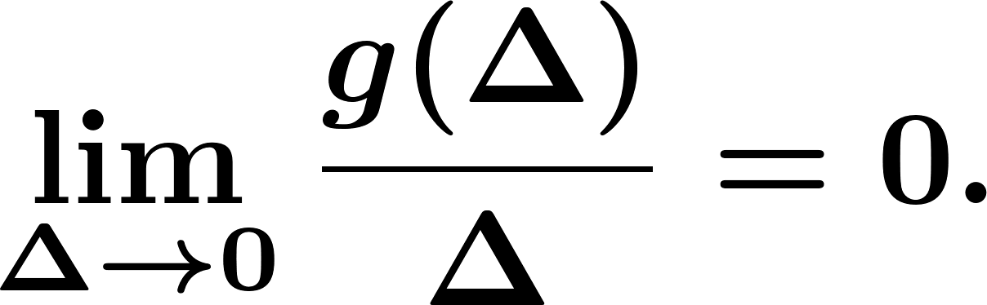
Poisson Processes
shows a function that is negligible compared to , as . More precisely, means that

Slide 22
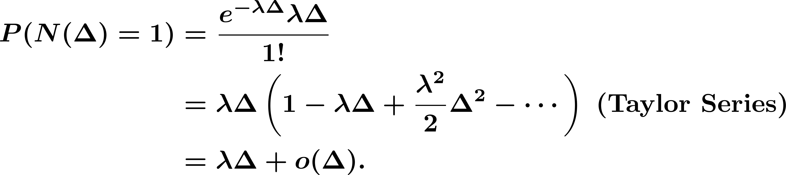
Poisson Processes

Slide 23
Poisson Processes
The Second Definition of the Poisson Process:
Let be fixed. The counting process is called a Poisson process with rate if all the following conditions hold:
has independent and stationary increments;
We have

Slide 24
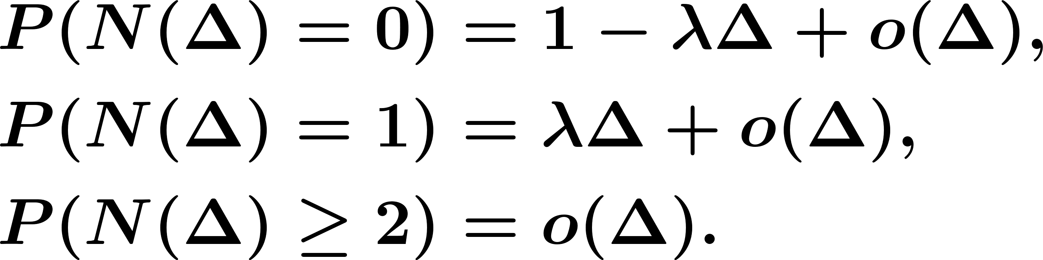
Poisson Processes
The Second Definition of the Poisson Process

Slide 25
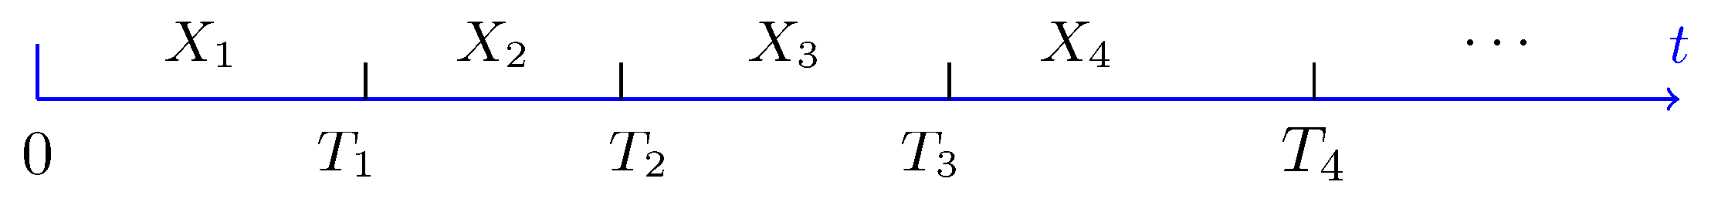

Poisson Processes
Arrival and Inter‐arrival times

Slide 26
Poisson Processes
Independent

Slide 27

Poisson Processes
Inter-arrival Times for Poisson Processes if is a Poisson process with rate , then the inter-arrival times . are independent and

Slide 28




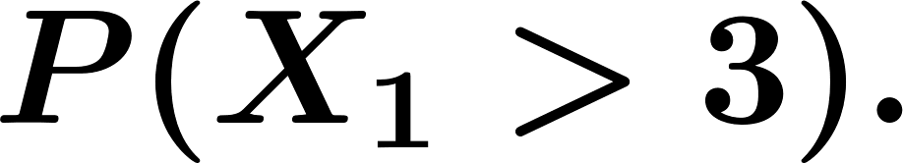


Poisson Processes
Example. Let be a Poisson process with intensity , and let . be the corresponding inter-arrival times.
Find the probability that the first arrival occurs after , i.e.,
Given that we have had no arrivals before , find
Given that the third arrival occurred at time , find the probability that the fourth arrival occurs after

Slide 29





Poisson Processes
I start watching the process at time . Let be the time of the first arrival that I see. In other words, is the first arrival after . Find and
I start watching the process at time . Let be the time of the first arrival that I see. Find the conditional expectation and the conditional variance of given that I am informed that the last arrival occurred at time

Slide 30
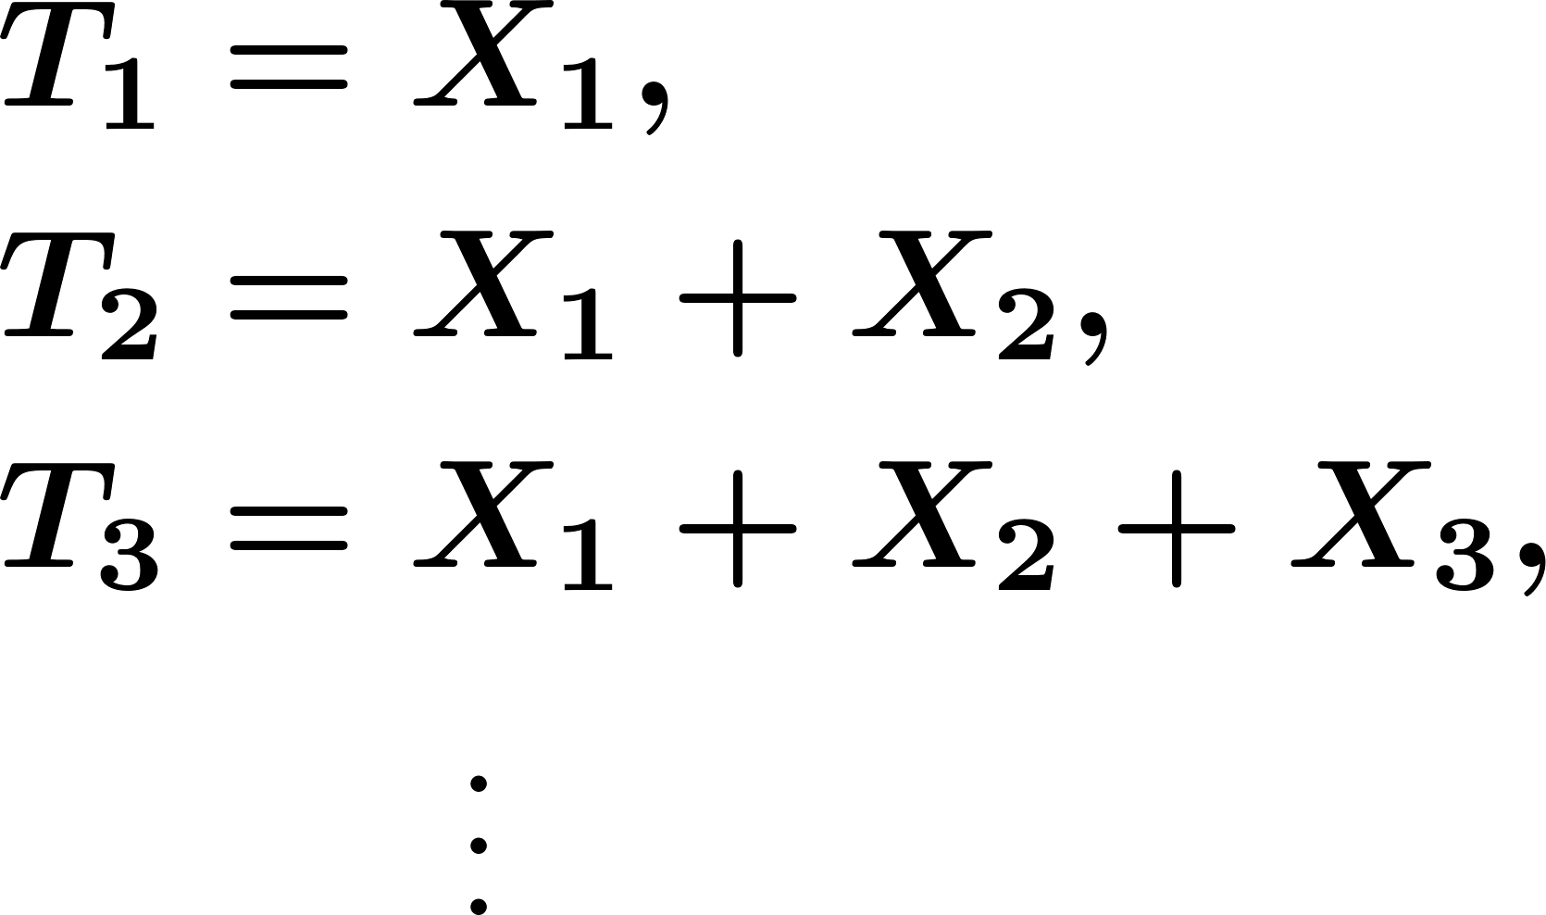
Poisson Processes
Arrival Times:

Slide 31
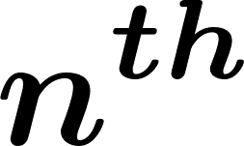
Poisson Processes
Arrival Times:
arrival

Slide 32
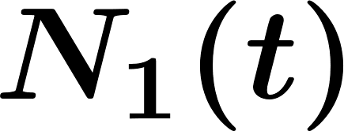
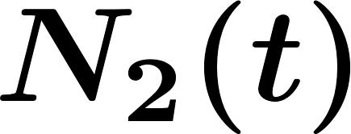
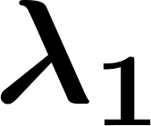
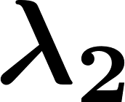
Merging and Splitting Poisson Processes
Merging Independent Poisson Processes:
Let and be two independent Poisson processes with rates and . respectively.
: Merged Process

Slide 33
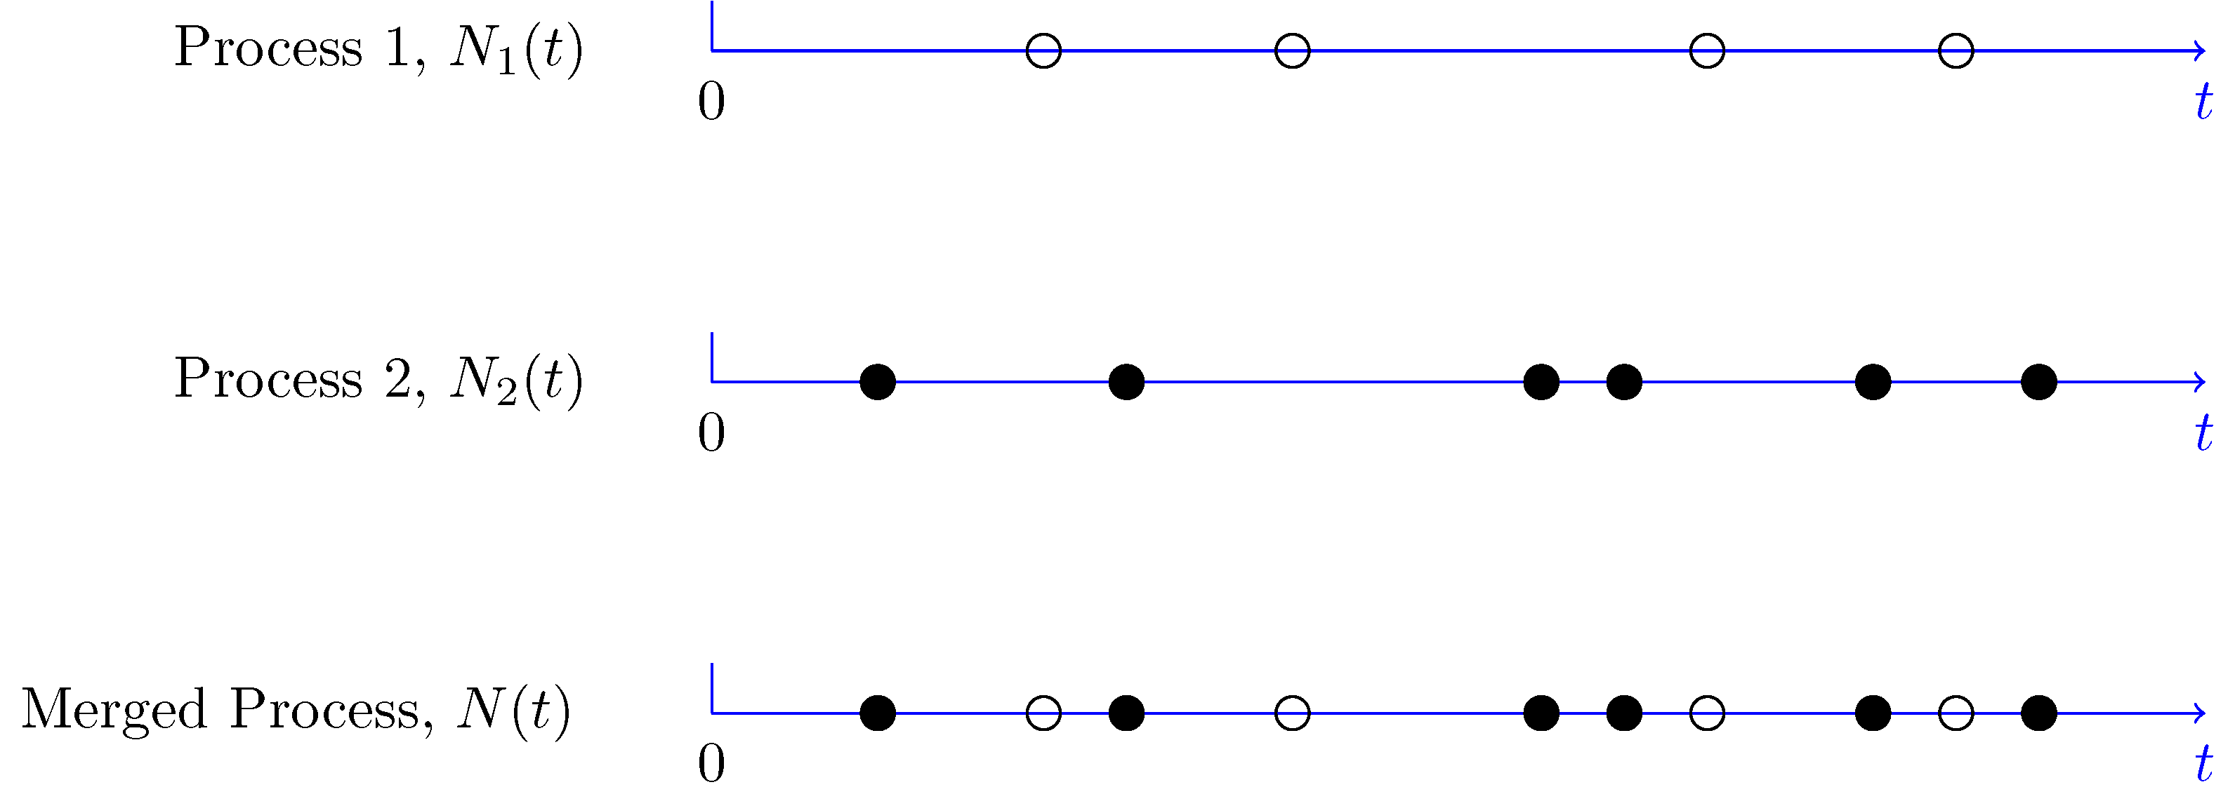
Merging and Splitting Poisson Processes

Slide 34

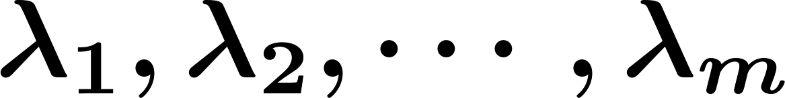
Merging and Splitting Poisson Processes
Merging Independent Poisson Processes
let be independent Poisson processes with rates . . Let also
Then, is a Poisson process with rate

Slide 35
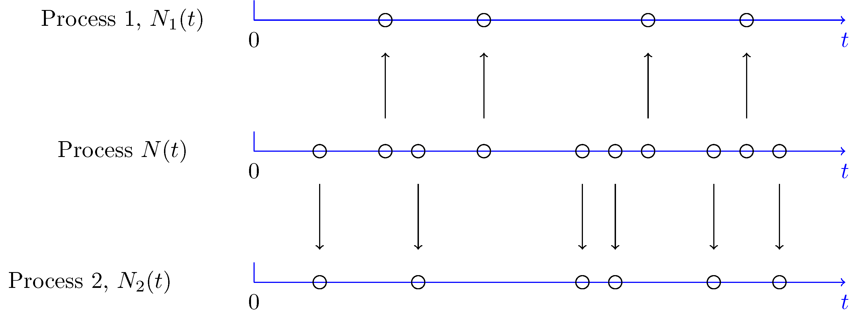
Merging and Splitting Poisson Processes
Splitting (Thinning) of Poisson Processes:

Slide 36
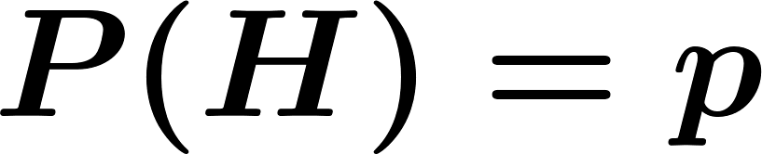
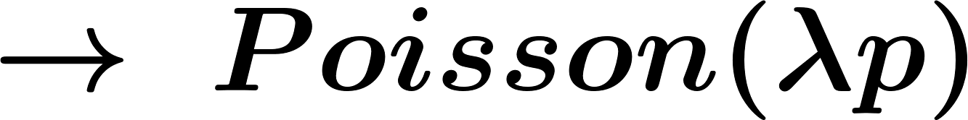


Merging and Splitting Poisson Processes
Toss a coin to decide up or down:
independent

Slide 37
Merging and Splitting Poisson Processes
Splitting a Poisson Processes
Let be a Poisson process with rate . Here, we divide to two processes and in the following way. For each arrival, a coin with . is tossed. If the coin lands heads up, the arrival is sent to the first process ( ), otherwise it is sent to the second process. The coin tosses are independent of each other and are independent of . Then,

Slide 38
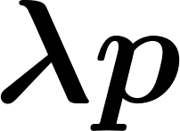
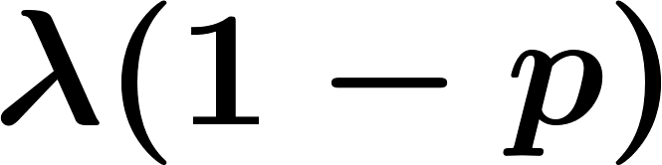
Merging and Splitting Poisson Processes
Splitting a Poisson Processes
is a Poisson process with rate ;
is a Poisson process with rate ;
and are independent.

Slide 39

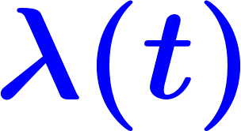
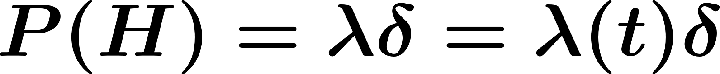
Nonhomogeneous Poisson Processes
Similar to Poisson process but .

Slide 40
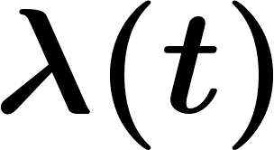
Nonhomogeneous Poisson Processes
Nonhomogeneous Poisson Process
Let be an integrable function. The counting process . is called a nonhomogeneous Poisson process with rate if all the following conditions hold.
has independent increments;

Slide 41

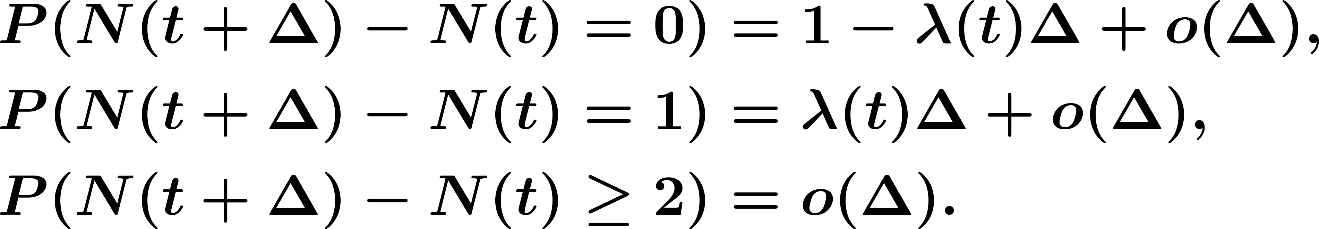
Nonhomogeneous Poisson Processes
for any , we have

Slide 42

Nonhomogeneous Poisson Processes
Thus
Independent

Slide 43



Nonhomogeneous Poisson Processes
Example. Let be a Poisson process with rate , and be its first arrival time. Show that given , then is uniformly distributed in . That is, show that

Slide 44

Nonhomogeneous Poisson Processes
More generally:
Given the locations of arrivals are uniformly and independently distribution in .

Slide 45


Nonhomogeneous Poisson Processes
Example. Let and be two independent Poisson processes with rates and , respectively. Find the probability that the second arrival in occurs before the third arrival in . Hint : One way to solve this problem is to think of and as two processes obtained from splitting a Poisson process.

Slide 46




Discrete-Time Markov Chains
In real life usually there is dependence between ‘s .
Markov chain:
depends on but not on the other pervious values.
Usually shows the state of the system at time .
W.L.G

Slide 47


Discrete-Time Markov Chains
Discrete-Time Markov Chains
Consider the random process , where . . We say that this process is a Markov chain if
for all . If the number of states is finite, e.g., . , we call it a finite Markov chain.

Slide 48
Discrete-Time Markov Chains
Transition probabilities

Slide 49


State Transition Matrix and Diagram
State Transition Matrix:
We often list the transition probabilities in a matrix. The matrix is called the state transition matrix or transition probability matrix and is usually shown by .

Slide 50


State Transition Matrix and Diagram
State Transition Diagram:
A Markov chain is usually shown by a state transition diagram.
Example.

Slide 51




State Transition Matrix and Diagram
Example. Consider the Markov chain shown in pervious example.
Find
Find
If we know , find
If we know , find

Slide 52

Probability Distributions
State Probability Distributions:
Consider a Markov chain , where
In general:
time 0

Slide 53



Probability Distributions
If we have , how do we find ?

Slide 54


Probability Distributions
Generally:

Slide 55

Probability Distributions
In matrix form:

Slide 56

Probability Distributions
More generally:

Slide 57





Probability Distributions
Example. Consider a system that can be in one of two possible states, . . In particular, suppose that the transition matrix is given by
Suppose that the system is in state 0 at time , i.e., .
Draw the state transition diagram.
Find the probability that the system is in state 1 at time

Slide 58



Probability Distributions
-Step Transition Probabilities:
Probability of going from state to state in exactly two transitions.
LOTP

Slide 59


Probability Distributions
Generally:
Probability of going from state to state in exactly transitions.
LOTP

Slide 60


Probability Distributions
Two step transition matrix:

Slide 61
Probability Distributions
The Chapman-Kolmogorov equation can be written as
The -step transition matrix is given by

Slide 62

Classification of States
Two states and are said to communicate, written as , if they are accessible from each other. In other words,

Slide 63




Classification of States
Communication is an equivalence relation. That means that
Every state communicates with itself
If , then
If and , then

Slide 64


Classification of States
Example. Consider the Markov chain shown in the following Figure. It is assumed that when there is an arrow from state to state , then . Find the equivalence classes for this Markov chain.

Slide 65


Classification of States
A Markov chain is said to be irreducible if all states communicate with each other.
Recurrent and transient states:
recurrent if
transient if

Slide 66

Classification of States
Consider a discrete-time Markov chain. Let be the total number of visits to state .
If is a recurrent state, then
If is a transient state, then

Slide 67

Classification of States
Periodicity:
Consider the Markov chain shown in
the following Figure. There is a periodic
pattern in this chain.

Slide 68









Classification of States
The period of a state is the largest integer satisfying the following property:
, where is not divisible by . The period of is shown by . If
, for all , then we let .
If , we say that state is periodic.
If , we say that state is aperiodic.
If , then .

Slide 69






Classification of States
Consider a finite irreducible Markov chain :
If there is a self-transition in the chain ( for some ), then the chain is aperiodic.
Suppose that you can go from state to state in steps, i.e., . Also suppose that . If , then state is aperiodic.

Slide 70


Classification of States
The chain is aperiodic if and only if there exists a positive integer such that all elements of the matrix are strictly positive, i.e.,

Slide 71

Using the Law of Total Probability with Recursion
Absorption Probabilities:
Example.
recurrent
recurrent
transient

Slide 72

Using the Law of Total Probability with Recursion

Slide 73


Using the Law of Total Probability with Recursion
How do we find ?
Main Idea: Apply the law of total probability

Slide 74




Using the Law of Total Probability with Recursion
Thus,
We also know and . Then we have

Slide 75


Using the Law of Total Probability with Recursion
Since , we conclude

Slide 76
Using the Law of Total Probability with Recursion
Similar idea (using LOTP) can be used to find.
Mean Hitting Times:
The expected time until the process hits a certain set of state for the first time.
Mean Return Times:
The expected time until returning to state .

Slide 77




Using the Law of Total Probability with Recursion
Mean Hitting Times
Consider a finite Markov chain with state space
. Let be a set of states. Let be the first time the
chain visits a state in . For all , define

Slide 78




Using the Law of Total Probability with Recursion
Mean Hitting Times
By the above definition, we have , for all . To find the unknown
values of ’s, we can use the following equations

Slide 79



Using the Law of Total Probability with Recursion
Example.
The number of steps needed until the chain hits the state 0 or 3 given

Slide 80



Using the Law of Total Probability with Recursion
Similarly, we can write
Solving the above equations, we obtain

Slide 81


Using the Law of Total Probability with Recursion
Mean Return Times:
return to state .

Slide 82







Using the Law of Total Probability with Recursion
Example. Consider the Markov chain shown in the following Figure. Let be the expected number of steps until the chain hits state 1 for the first time, given that . Clearly, . Also, let be the mean return time to state 1.
Find and .
Find .

Slide 83



Using the Law of Total Probability with Recursion
Mean Return Times
Consider a finite irreducible Markov chain with state
space . Let be a state. Let be the mean return
time to state . Then

Slide 84

Using the Law of Total Probability with Recursion
Mean Return Times
where is the expected time until the chain hits state given . Specifically,

Slide 85
Stationary and Limiting Distributions
long-term behavior of Markov chains
The fraction of time that the Markov chain spends at state as time .

Slide 86






Stationary and Limiting Distributions
Example. Consider a Markov chain with two possible states, . In particular, suppose that the transition matrix is given by
where and are two real numbers in the interval such that . . Suppose that the system is in state 0 at time with probability , i.e.,

Slide 87


Orchestrated Conversation: Stationary and Limiting Distributions
Where .
Using induction (or any other method), show that

Slide 88


Orchestrated Conversation: Stationary and Limiting Distributions
Show that
Show that

Slide 89


Stationary and Limiting Distributions
The initial state ( ) does not matter as becomes large. Thus, we can write

Slide 90




Stationary and Limiting Distributions
Limiting Distributions
The probability distribution is called the limiting distribution of the Markov chain if
for all , and we have

Slide 91

Stationary and Limiting Distributions
How to find the limiting distribution?
Finite Markov chains:
So solve Steady-state (limiting) distribution
Steady-state

Slide 92

Stationary and Limiting Distributions
Theorem. Consider a finite Markov chain where
. Assume that the chain is irreducible and
aperiodic. Then,
The set of equations
has a unique solution.

Slide 93


Stationary and Limiting Distributions
The unique solution to the above equations is the limiting distribution of the Markov chain, i.e.,
for all .
We have
where is the mean return time to state .

Slide 94

Orchestrated Conversation: Stationary and Limiting Distributions
Example. Consider the Markov chain shown in the following Figure.
Is this chain irreducible?
Is this chain aperiodic?
Find the stationary distribution
for this chain.
Is the stationary distribution a limiting
distribution for the chain?

Slide 95



Stationary and Limiting Distributions
Countably Infinite Markov Chains:
Let be a recurrent state. Assuming , let be the number of transitions needed to return to state , i.e.,
If , then is said to be positive recurrent. If
, then is said to be null recurrent.

Slide 96
Stationary and Limiting Distributions
Theorem. Consider an infinite Markov chain where
. Assume that the chain is irreducible and aperiodic.
Then, one of the following cases can occur:
All states are transient, and
All states are null recurrent, and

Slide 97

Stationary and Limiting Distributions
All states are positive recurrent. In this case, there exists a limiting distribution, , where
for all . The limiting distribution is the unique solution to the equations

Slide 98


Stationary and Limiting Distributions
We also have
where is the mean return time to state .

Slide 99


Stationary and Limiting Distributions
Example. Consider the Markov chain shown in the following Figure. Assume that . Does this chain have a limiting distribution?

Slide 100
Practicing some problems on Markov Chains
Absorption Probabilities
Consider a finite Markov chain with state space
. Suppose that all states are either absorbing or
transient. Let be an absorbing state. Define

Slide 101



Practicing some problems on Markov Chains
By the above definition, we have , and if is any other
absorbing state. To find the unknown values of ’s, we can use the following
equations

Slide 102





Practicing some problems on Markov Chains
Example 2. Consider the Markov chain in the following Figure. There are two recurrent classes, , and . Assuming , find the probability that the chain gets absorbed in .

Slide 103
Practicing some problems on Markov Chains
Mean Hitting Times
Consider a finite Markov chain with state space
. Let be a set of states. Let be the first time the
chain visits a state in . For all , define

Slide 104
Practicing some problems on Markov Chains
Mean Hitting Times
By the above definition, we have , for all . To find the unknown
values of ’s, we can use the following equations

Slide 105


Practicing some problems on Markov Chains
Example. Consider the Markov chain of previous Example. Again assume . . We would like to find the expected time (number of steps) until the chain gets absorbed in or . More specifically, let be the absorption time, i.e., the first time the chain visits a state in or . We would like to find

Slide 106
Practicing some problems on Markov Chains
Mean Return Times
Consider a finite irreducible Markov chain with state
space . Let be a state. Let be the mean return
time to state . Then

Slide 107
Practicing some problems on Markov Chains
Mean Return Times
where is the expected time until the chain hits state given . Specifically,

Slide 108




Practicing some problems on Markov Chains
Example. Consider the Markov chain shown in the following Figure. Assume . , and let be the first time that the chain returns to state 1, i.e.,
Find

Slide 109

Brownian Motion (Wiener Process)
Brownian motion is another widely-used random process. The following Figure shows a sample path of Brownian motion.

Slide 110





Brownian Motion (Wiener Process)
Divide the half-line to tiny subintervals of length
We define the random variables as follows. if the th coin toss results in heads, and if the th coin toss results in tails. Thus,

Slide 111




Brownian Motion (Wiener Process)
Now, we define the process as follows. We let . At time the value of is given by

Slide 112



Brownian Motion (Wiener Process)
Moreover, the ’s are independent. Note that

Slide 113



Brownian Motion (Wiener Process)
We know that,
Thus,

Slide 114

Brownian Motion (Wiener Process)
BM: Gaussian

Slide 115


Brownian Motion (Wiener Process)
Standard Brownian Motion
A Gaussian random process is called a (standard) Brownian motion or a (standard) Wiener process if
For all

Slide 116
Brownian Motion (Wiener Process)
has independent increments. That is, for all
, the random variables
are independent;
has continuous sample paths.

Slide 117



Brownian Motion (Wiener Process)
Example. Let be a standard Brownian motion. For all , find
Let’s assume

Slide 118



Brownian Motion (Wiener Process)
Then,
For
We conclude

Slide 119

Brownian Motion (Wiener Process)
Example. Let be a standard Brownian motion.
Find
Find

Slide 120
Post-work for Lesson
Complete homework assignment for Lessons 18-20:
HW#11 and HW#12
Go to the online classroom for details.

